Slide 1
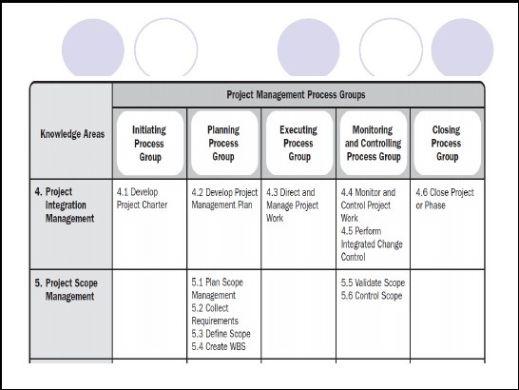
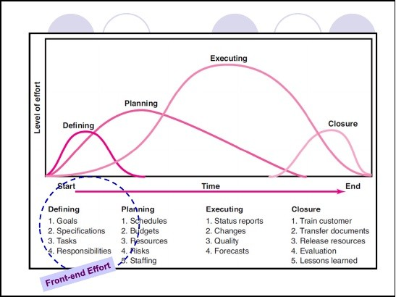
ENGG461: Week 2
Project Integration and Scope Mgmt.
(Source: PMBOK Guide, 5th Edition; p. 60)
Project Life Cycle – Recap
(Source: Gray and Larson; p. 7)

Slide 2
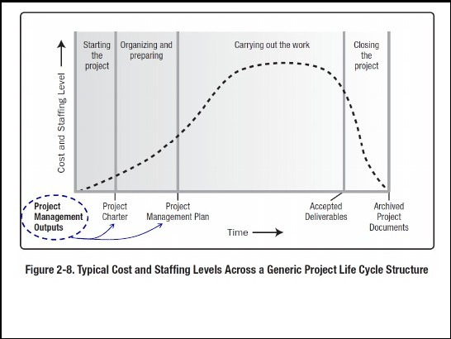
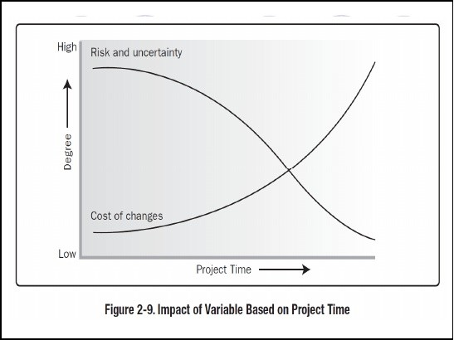
8/18/2019 Week 2_Lecture ENGG461– Managing Engineering Projects
http://slidepdf.com/reader/full/week-2lecture-engg461-managing-engineering-projects 2/24
(Source: PMBOK Guide, 5th Edition; p. 38)
/ Opportunity to add value
(Source: PMBOK Guide, 5th Edition; p. 39)

Slide 3


8/18/2019 Week 2_Lecture ENGG461– Managing Engineering Projects
http://slidepdf.com/reader/full/week-2lecture-engg461-managing-engineering-projects 3/24
Front-end Effort?
Need identification
End-product concept embodiment
Project evaluation and selection
OPre-feasibility/feasibility studies
OEconomic/financial evaluation
Project Charter
Project Scope Statement
Initial project plans
Conceptual Development?
Identify client needs or problem to be solved
Check project and end-product validity and feasibility
Evaluate alternative approaches to meeting the need or dealing with the problem
Define project objectives and constraints
O Project definition: objectives; scope; deliverables; milestones
Request for proposal ?

Slide 4

8/18/2019 Week 2_Lecture ENGG461– Managing Engineering Projects
http://slidepdf.com/reader/full/week-2lecture-engg461-managing-engineering-projects 4/24
Learning Objectives
develop a project charter and illustrate their use
analyse and suggest potential solutions to certain problems encountered during project execution
Identify (establish) scope for an engineering project and develop a work breakdown structure at an appropriate level of detail
analyse and determine if the scope of work on the project has changed and determine methods to accommodate such changes
Project Integration Management
Develop the project charter: compile a document that authorises the project or a project phase
Develop the project management plan: develop the initial high level framework for integrating and incorporating all subsidiary project plans
Direct and manage the project execution: provide the overall direction and guidance for performing the project work to ensure that the planned
project outcomes are delivered
Monitor and control project work: endeavour to maintain the project performance targets, by way of monitoring progress while dealing with variations.
Perform integrated change control: track and review all changes requested and incorporated into the project and evaluate their effect on the desired project outcomes
Close project or phase: ensure orderly completion of all project activities

Slide 5
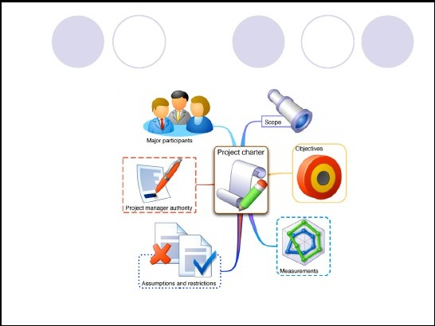
8/18/2019 Week 2_Lecture ENGG461– Managing Engineering Projects
http://slidepdf.com/reader/full/week-2lecture-engg461-managing-engineering-projects 5/24
Project Charter?
The document that authorises the project:
Source: http://www.nmbsolutions.ca/blog/project-charter-%E2%80%93-more-just-document
Project vs. Product Scope
Project scope: what needs to be done to accomplish project goals (i.e. deliverables: end-product; process; service; or solution/result)
O also, what needs not to be done (sets the boundary!) – scope creep!
: features and functions that c^{P}h^{r}aºr^{d}a^{u}c^{c}te^{t}r^{s}is^{c}eºt^{p}h^{e}e product, service or solution/result
O governed by technical requirements, limits and exclusions (set the specifications)
O End-product – a new building; a new bridge; a renovated facility; an upgraded IT system in operation; restructured organisation
O Project – the processes that go together to materialise the end product (building; bridge; IT system etc.)

Slide 6







8/18/2019 Week 2_Lecture ENGG461– Managing Engineering Projects
http://slidepdf.com/reader/full/week-2lecture-engg461-managing-engineering-projects 6/24
Scope Management (PMBOK)
Collecting requirements: gather stakeholder expectations
on the project and product deliverables
Define scope: describe in detail the project and product expectations
Create WBS: draw a hierarchical pictorial illustration of work that needs to be completed to deliver on project and product expectations
Verify scope: obtain formal acceptance on the work to be completed, by all key (relevant) stakeholders
Control scope: endeavour to maintain the agreed project and product scope by way of consistent monitoring of work performance against the scope baseline.
Scope Elements (Check List?)
(PMBOK)
Product scope descriptions
Product acceptance criteria
Project deliverables
Project exclusions
Project constraints
Project assumptions
4–12

Slide 7
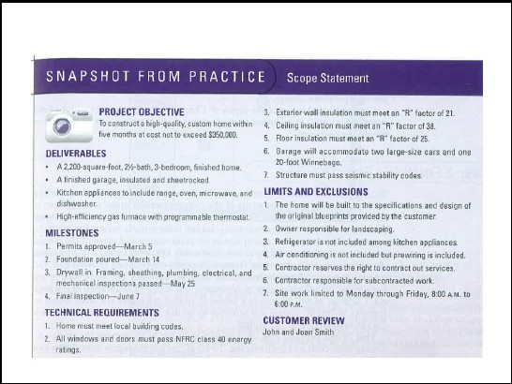
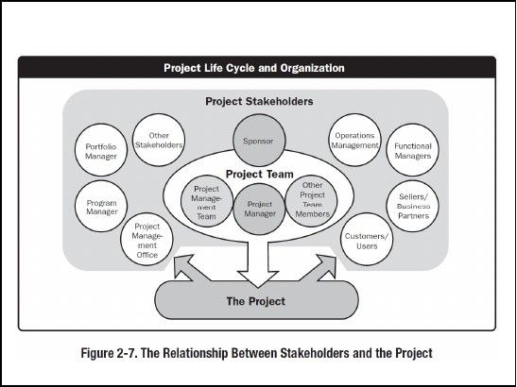
8/18/2019 Week 2_Lecture ENGG461– Managing Engineering Projects
http://slidepdf.com/reader/full/week-2lecture-engg461-managing-engineering-projects 7/24
Scope Statement: Example
(Source: Gray and Larson; p. 105)
Stakeholder Identification
(Source: PMBOK Guide, 5th Edition; p.30)

Slide 8
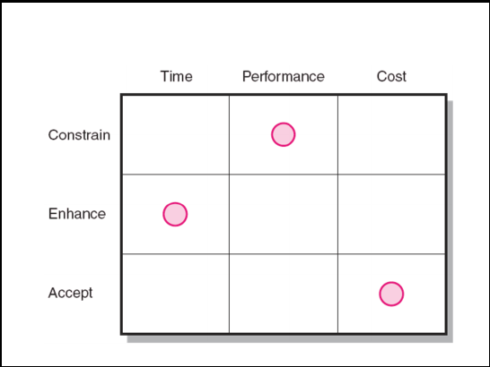


8/18/2019 Week 2_Lecture ENGG461– Managing Engineering Projects
http://slidepdf.com/reader/full/week-2lecture-engg461-managing-engineering-projects 8/24
Project Priority Matrix
Work Breakdown Structure (WBS)
A hierarchical outline (map) that identifies the products and work elements involved in a project
Defines the relationship of the final deliverable _{t}(th_{he}e_{ir} p_{re}ro_{la}je_{ti}c_{o}t)_{ns}to_{hip}it_{s} s_{to}ub_{w}-d_{ork}eliv_{p}e_{a}r_{c}a_{k}b_{a}le_{g}s_{e},_{s}and in turn,
Best suited for design and build projects that have tangible outcomes rather than process-oriented projects
(Source: Gray and Larson, 2011)

Slide 9
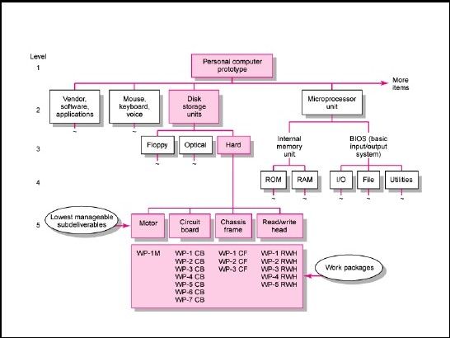

8/18/2019 Week 2_Lecture ENGG461– Managing Engineering Projects
http://slidepdf.com/reader/full/week-2lecture-engg461-managing-engineering-projects 9/24
Work Breakdown Structure
(Source: Gray and Larson, 2011)
How WBS Helps the Project Manager
Facilitates evaluation of cost, time, and technical performance of the organization on a project
Provides management with information appropriate to each organizational level
Helps in the development of the organization breakdown structure (OBS). which assigns project responsibilities to organizational units and individuals
Helps manage plan, schedule, and budget
Defines communication channels and assists in coordinating the various project elements
(Source: Gray and Larson, 2011)

Slide 10

8/18/2019 Week 2_Lecture ENGG461– Managing Engineering Projects
http://slidepdf.com/reader/full/week-2lecture-engg461-managing-engineering-projects 10/24
Work Packages
A work package is the lowest level of the WBS.
It is output-oriented in that it:
Defines work (what).
Identifies time to complete a work package (how long).
Identifies a time-phased budget to complete a work package (cost).
Identifies resources needed to complete a work package (how much).
Identifies a person responsible for units of work (who).
Identifies monitoring points (milestones) for measuring success.
(Source: Gray and Larson, 2011)
Integrating the WBS with the Organization
Organizational Breakdown Structure (OBS)
–Depicts how the firm is organized to discharge its work responsibility for a project.
Provides a framework to summarize organization work unit performance
Identifies organization units responsible for work packages
Ties the organizational units to cost control accounts
(Source: Gray and Larson, 2011)

Slide 11
8/18/2019 Week 2_Lecture ENGG461– Managing Engineering Projects
http://slidepdf.com/reader/full/week-2lecture-engg461-managing-engineering-projects 11/24
Integration of WBS and OBS
(Source: Gray and Larson, 2011)
Coding the WBS for the Information System
WBS Coding System
–Defines:
Levels and elements of the WBS
Organization elements
Work packages
Budget and cost information
–Allows reports to be consolidated at any level in the organization structure
(Source: Gray and Larson, 2011)

Slide 12
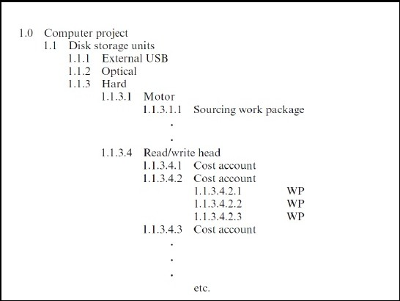
8/18/2019 Week 2_Lecture ENGG461– Managing Engineering Projects
http://slidepdf.com/reader/full/week-2lecture-engg461-managing-engineering-projects 12/24
WBS Coding
(Source: Gray and Larson, 2011)
Responsibility Matrices
Responsibility Matrix (RM)
–Also called a linear responsibility chart.
–Summarizes the tasks to be accomplished and who is responsible for what on the project.
Lists project activities and participants
Clarifies critical interfaces between units and individuals that need coordination
Provide an means for all participants to view their responsibilities and agree on their assignments
Clarifies the extent or type of authority that can be exercised by each participant
(Source: Gray and Larson, 2011)

Slide 13
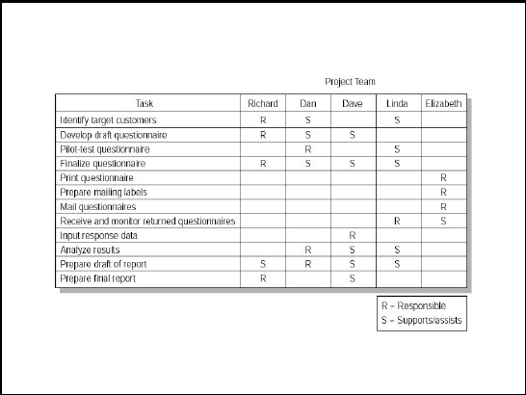
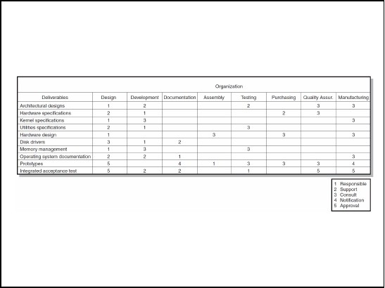
8/18/2019 Week 2_Lecture ENGG461– Managing Engineering Projects
http://slidepdf.com/reader/full/week-2lecture-engg461-managing-engineering-projects 13/24
Responsibility Matrix for a Market Research Project
(Source: Gray and Larson, 2011)
Responsibility Matrix for the Conveyor Belt Project
(Source: Gray and Larson, 2011)

Slide 14
8/18/2019 Week 2_Lecture ENGG461– Managing Engineering Projects
http://slidepdf.com/reader/full/week-2lecture-engg461-managing-engineering-projects 14/24
Project Evaluation and Selection
Strategic fit: how well the candidate project(s) align and/or ad value to the existing portfolio of projects/businesses
Technical feasibility: whether the know-how and capabilities are sufficient to delivery results (product functions, service levels etc.) or solve the problem
Economic value:
OSingle project: economic value/viability (benefits/costs; IRR)
OMultiple projects: relative merit (incremental benefit-cost ratio; discounted cash flow; pay-back period, IRR. ROI)
The role of West Link/M7? – Sydney orbital
The role of Dombarton-Maldon rail link? – South Sydney Freight Corridor
Is the proposed solution to this problem technically feasible?
Do we have the technical knowhow to solve this
problem?
At what cost and within what timeframe we can acquire new technology/knowhow?
What are the monetary and non-monetary benefits of the end product/service relative to costs?

Slide 15
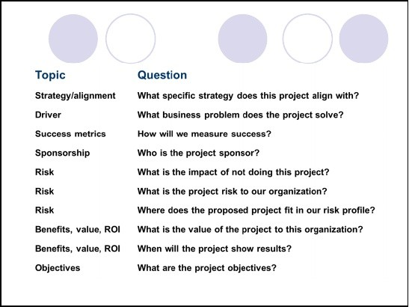
8/18/2019 Week 2_Lecture ENGG461– Managing Engineering Projects
http://slidepdf.com/reader/full/week-2lecture-engg461-managing-engineering-projects 15/24
Checklist model
Evaluation Models
O Uses a list of questions to review potential projects and to determine their acceptance or rejection (shortlisting/screening)
O Fails to answer the relative importance or value of a potential project and doesn’t to allow for comparison with other potential projects
Multi-weighted scoring model
O Uses several weighted qualitative and/or quantitative selection criteria to evaluate project proposals (shortlisting/screening)
O Allows for comparison of projects with other potential projects
Economic models
O Uses quantitative methods: payback, net present value (NPV), internal rate of return (IRR) to evaluate the financial attractiveness/viability
O All benefits and costs should be expressed in monetary terms?
Check Lists…
(Source: Gray and Larson, 2011)

Slide 16
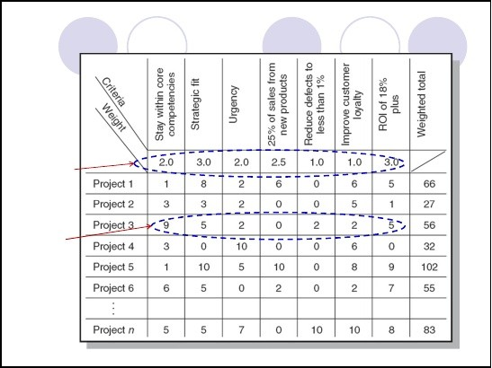
8/18/2019 Week 2_Lecture ENGG461– Managing Engineering Projects
http://slidepdf.com/reader/full/week-2lecture-engg461-managing-engineering-projects 16/24
Check Lists (cont.)…
Question
Topic
Organization culture Is our organization culture right for this type of project?
Resources Will internal resources be available for this project? Approach Will we build or buy?
Schedule How long will this project take?
Schedule Is the time line realistic?
Training/resources Will staff training be required? Finance/portfolio What is the estimated cost of the project?
Portfolio Is this a new initiative or part of an existing initiative? Portfolio How does this project interact with current projects? Technology Is the technology available or new?
(Source: Gray and Larson, 2011)
Weighted scoring models
Weightings
Scores
IT Projects at Frontier Airlines (Source: Gray and Larson, 2011)

Slide 17
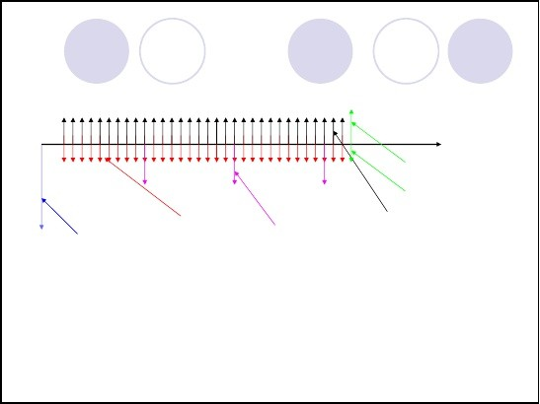
8/18/2019 Week 2_Lecture ENGG461– Managing Engineering Projects
http://slidepdf.com/reader/full/week-2lecture-engg461-managing-engineering-projects 17/24
Economic Evaluation
Considers Benefits vs. Costs
positive and negative benefits; investment costs
Uses two generic approaches
Benefits/Costs: Ratio
Benefits – Costs: Difference
May or may not take time value of money into account (however, in most cases it does!)
Methods (many available):
Benefit/Cost Ratio; Pay-back Period; Present Worth; Future Worth; Annual Worth; Internal Rate of Return
Cash-flow diagrams
Cash inflows [+]
time Salvage
disposal
Operating & Initial Capital Maintenance
Cost Costs
Replacement Costs
Income
Cash outflows [-]
Time value of money? Inflation! Opportunity cost!

Slide 18
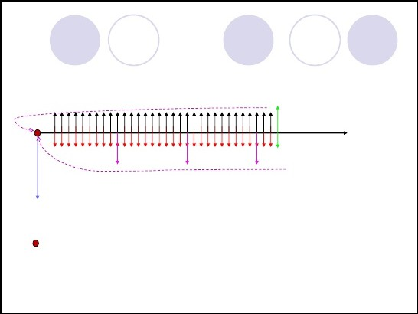
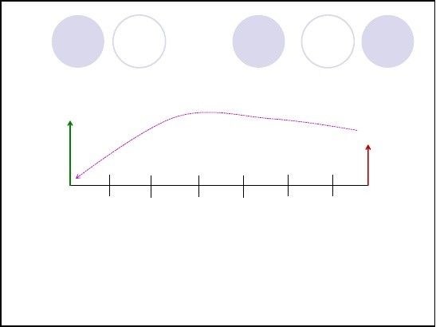
8/18/2019 Week 2_Lecture ENGG461– Managing Engineering Projects
http://slidepdf.com/reader/full/week-2lecture-engg461-managing-engineering-projects 18/24
Discounting (net present value)
time
NPV = Sum of all cash flows discounted to the present point in time?
Single sum
P
F
n ( i )

Slide 19
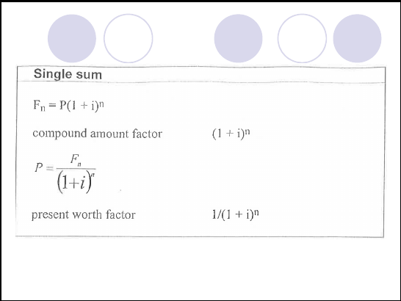
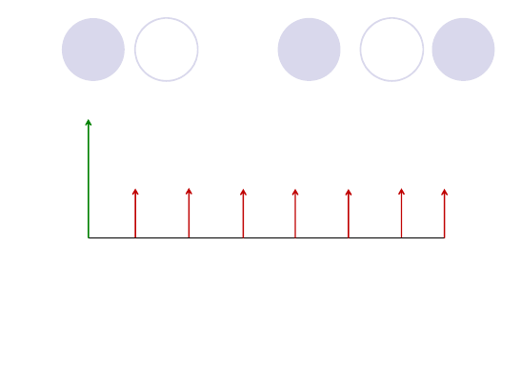
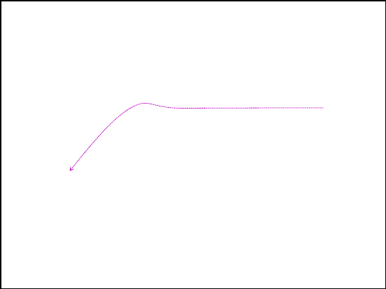
8/18/2019 Week 2_Lecture ENGG461– Managing Engineering Projects
http://slidepdf.com/reader/full/week-2lecture-engg461-managing-engineering-projects 19/24
Formulae for Economic Evaluation
Present sum and uniform series
P
A
A
A
A
A
A
A
n ( i )

Slide 20
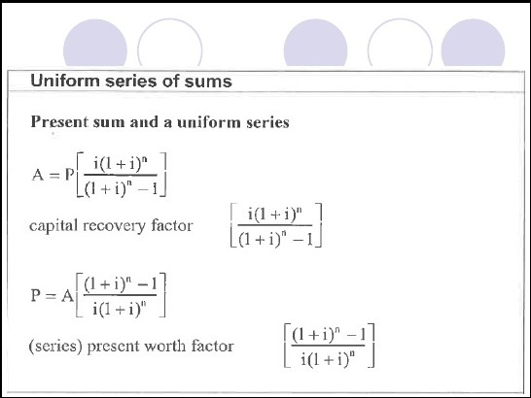
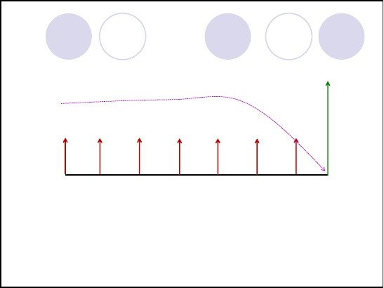
8/18/2019 Week 2_Lecture ENGG461– Managing Engineering Projects
http://slidepdf.com/reader/full/week-2lecture-engg461-managing-engineering-projects 20/24
Formulae for Economic Evaluation
Uniform series and a future sum
F
A
A
A
A
A
A
A
n ( i )

Slide 21
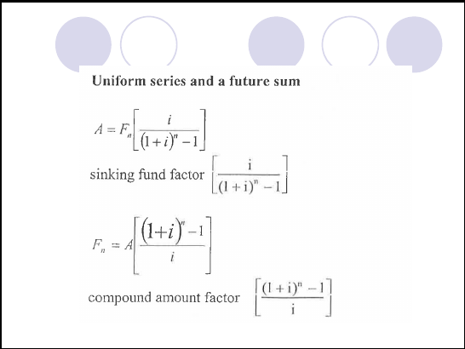


8/18/2019 Week 2_Lecture ENGG461– Managing Engineering Projects
http://slidepdf.com/reader/full/week-2lecture-engg461-managing-engineering-projects 21/24
Formulae for Economic Evaluation
Benefit-cost Ratio/Profitability index
Single Project:
OBenefits/Costs > 1 (desired)
OBenefits/Costs = 1 (acceptable; political reasons?)
OBenefits/Costs < 1 (rejected)
Multiple Projects:
OIncremental Benefit/Cost Analysis
OShort-list alternatives with Benefit/Cost >1
OPair-wise comparison of relative benefits/costs
∆Benefits/∆Costs > 1 select higher cost option
∆Benefits/∆Costs = 1 (indifferent; political reasons?)
∆Benefits/∆Costs < 1 (select lower cost option)
https://www.youtube.com/watch?v=REA6UNAnMF4

Slide 22

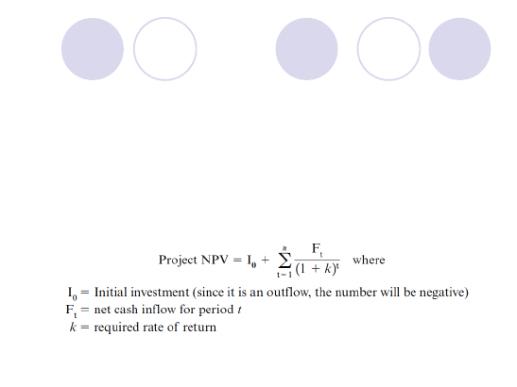

8/18/2019 Week 2_Lecture ENGG461– Managing Engineering Projects
http://slidepdf.com/reader/full/week-2lecture-engg461-managing-engineering-projects 22/24
Simple Pay-back Period Method
The time (number of years) taken to recover/recoup initial investment
Simple (non-discounted) Payback Period Method
OMeasures the time the project will take to recover the project investment
O Uses more desirable shorter paybacks
OEmphasizes cash flows, a key factor in business
Limitations of the Simple Payback Period Method:
OIgnores the time value of money.
OAssumes cash inflows for the investment period only
ODoes not consider profitability.
(Source: Gray and Larson, 2011)
Discounted Cash-flow/NPV Method
The Net Present Value (NPV) Model
O Uses management’s minimum desired rate-of-return (discount rate) to compute the present value of all net cash inflows.
Positive NPV: project meets minimum desired rate
of return and is eligible for further consideration.
Negative NPV: project is rejected.
(Source: Gray and Larson, 2011)
https://www.youtube.com/watch?v=qAhV3xG0i8s

Slide 23

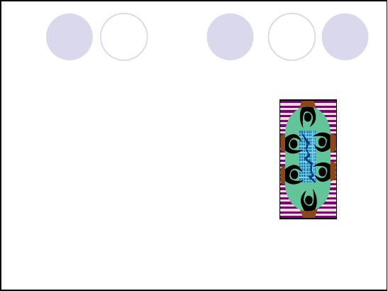
8/18/2019 Week 2_Lecture ENGG461– Managing Engineering Projects
http://slidepdf.com/reader/full/week-2lecture-engg461-managing-engineering-projects 23/24
Internal Rate of Return (IRR) Method
The rate of interest (discount rate) at which the benefits and costs are equal (break even)
Can be applied to both Benefit/Cost ratio and the Benefits – Costs Methods (e.g. PW)
May need to use trial and error/interpolation/extrapolation, if manual solved
https://www.youtube.com/watch?v=i8BTMqZgqbQ
Project Portfolio Matrix Dimensions
Bread-and-butter Projects
O Involve evolutionary improvements to current products and services.
Pearls
O Represent revolutionary commercial
opportunities using proven technical advances.
Oysters
O Involve technological breakthroughs with high commercial payoffs.
White Elephants
O Showed promise at one time but are no longer viable.

Slide 24
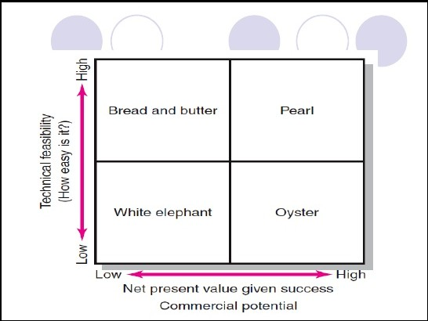
8/18/2019 Week 2_Lecture ENGG461– Managing Engineering Projects
Project Portfolio Matrix
Summary…
Early decisions have a big impact
Good decisions can cost time and money to make
•
d^{The}epe ªn^{p}d^{p}s^{ro}o^{p}n^{ri}cªo^{te}stªo^{m}f ºw^{u}ro^{nt}ng^{of}d“e^{F}c^{ro}is^{n}io^{t} n^{E}s^{nd}co^{E}m^{ff}pºa^{rt}r”ed to cost of getting more information
Tools and techniques are there to support decision making (only!)…Excel has built in functions/macros for all (or most of the) techniques/formulae
http://slidepdf.com/reader/full/week-2lecture-engg461-managing-engineering-projects
24/24

